Slide 1
Eye-See-You: Eye Gaze Prediction using Deep Learning
Anita de Mello Koch, Ji Won Chung,
Skye Thompson, and Arthur Chen

Slide 2

Mental Health

Slide 3

Virtual Assistant

Slide 4
WebGazer

Slide 5
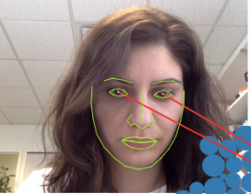
WebGazer
Scalable
Extracts information locally
Everyday computers
Integrate a pipeline that is already scalable and accessible

Slide 6
WebGazer Dataset
120 Eye Gaze Features
Low Resolution 640 x 480
MediaPipe for Facial Feature Extraction
High Fidelity Eye Tracking Data with Tobius

Slide 7
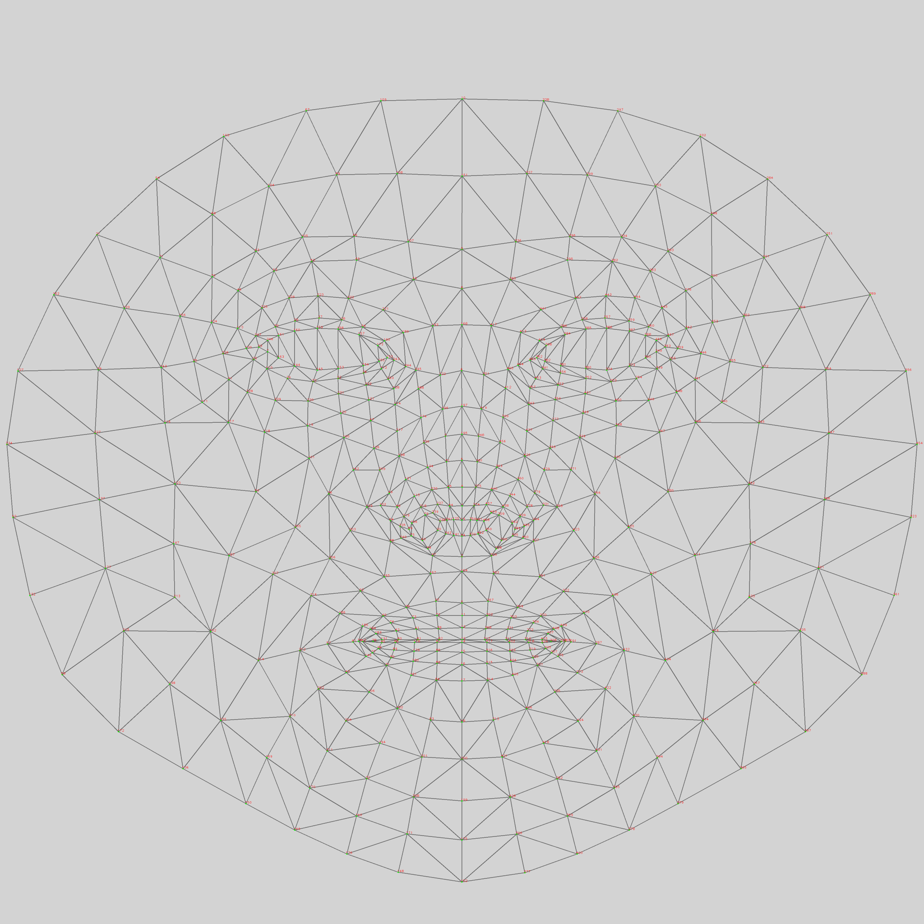
Media Pipe
MediaPipe for Facial Feature Extraction
Red dot is a key facial feature

Slide 8
Blink Detection and Extraction

Slide 9

Eye Aspect Ratio
Eye aspect ratio (EAR)
Soukupová et al.
0.2 Threshold == Blink

Slide 10
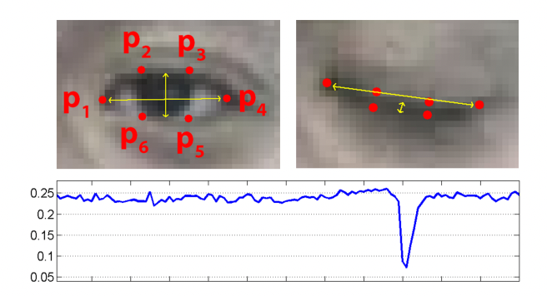
Blink Detection
120 Eye Gaze Features
Low Resolution 640 x 480
Corresponding P1- P6 in MediaPipe
Left: [362, 385, 387, 263, 373, 380]
Right: [33, 160, 158, 133, 153, 144]

Slide 11
Network Architectures

Slide 12
Comparative Approach
3 Models with Just Eye Trajectories and 1 Model with Blink Data
CNN, Split CNN, LSTM
Chose one of these models that performed the best for Blink Detection

Slide 13
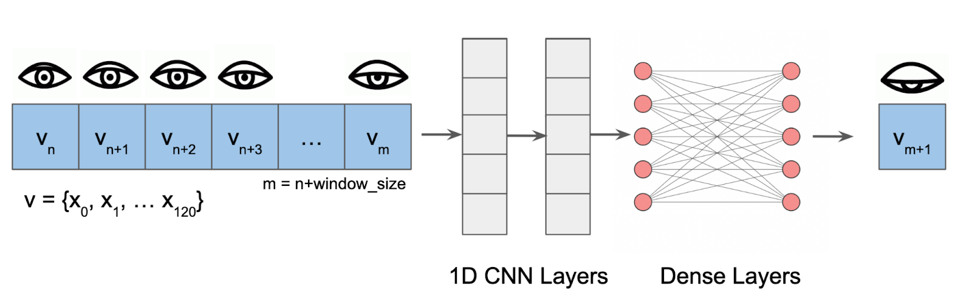
Model 1 - CNN Overview

Slide 14
Model 1 - CNN
Eye Trajectories
120 Features
x₁,x₂, …, x₁₂₀
Predicted Eye Trajectories
tanh
BatchNorm
tanh
CNN 1D
Dropout
BatchNorm
tanh
CNN 1D
Dropout
Flatten
Dense
Dropout
Dense

Slide 15
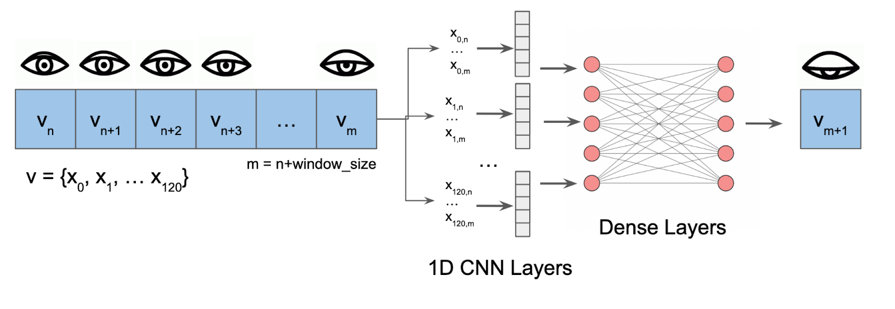
Model 2 - Split CNN

Slide 16
Model 2 - Split CNN
Eye Trajectories
Feature x₁
CNN₁
tanh
Predicted Eye Trajectories
.
..
Eye Trajectories
Feature x_{i}
CNN_{i}
tanh
BatchNorm
Dense
Dense
Concatenated 120 CNN Outputs
tanh
Dropout
.
..
Eye Trajectories
Feature x₁₂₀
CNN₁₂₀
tanh

Slide 17
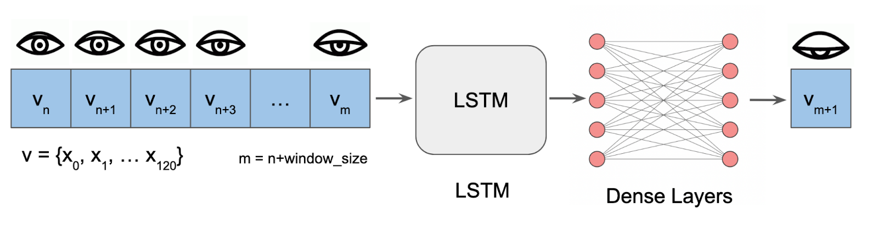
Model 3 - LSTM

Slide 18
Model 4 - Blink Split CNN
Predicted Eye Trajectories
Eye Trajectories
Feature x₁
CNN₁
tanh
tanh
BatchNorm
Dense
BatchNorm
Dense
Dense
Dropout
Dropout
.
..
Eye Trajectories
Feature x_{i}
Concatenated Blink + Eye Predictions
CNN_{i}
Concatenated 120 CNN Outputs
tanh
Predicted Blinks
.
..
tanh
BatchNorm
Dense
tanh
Dense
BatchNorm
sigmoid
Dense
Eye Trajectories
Feature x₁₂₀
Dropout
Dropout
CNN₁₂₀
tanh

Slide 19
Performance Evaluation

Slide 20
Huber Loss Function
Robust Regression
Better for noisy data because less sensitive to outliers
Eye features are not normalized
Features range to -300 to 300 with some values at 0

Slide 21
Mean Squared Error for Performance
Eye feature values are high
4000 - 2000 Ranges is Expected
MSE of 3000 ~ 54 on a (-300, 300) scale

Slide 22
Findings

Slide 23
Model Tuning
Focus of Compute Power
Varying Learning Rate, Fixed Window Size
Fixed Learning Rate, Varying Window Size

Slide 24
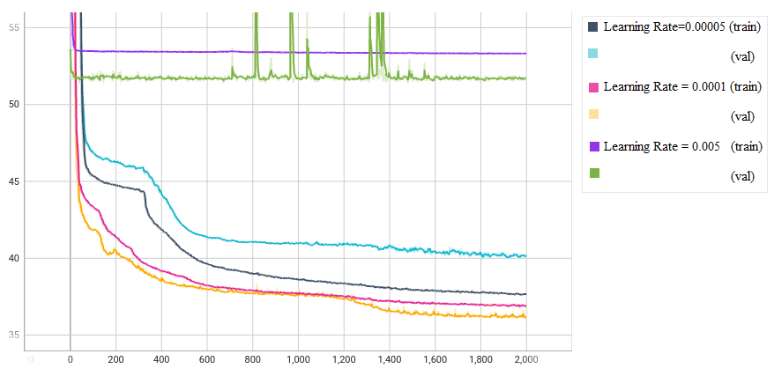
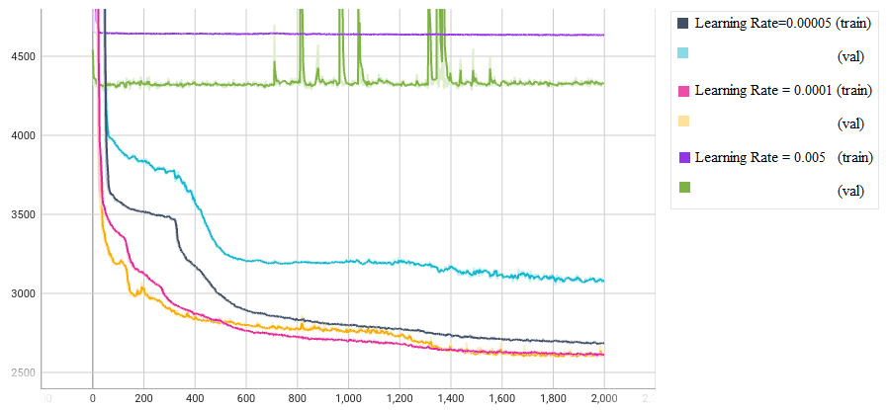
Varied Learning Rate, Fixed Window Size
Hubert Loss
MSE

Slide 25
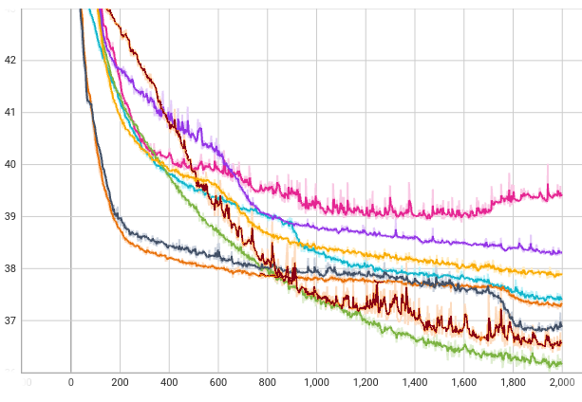
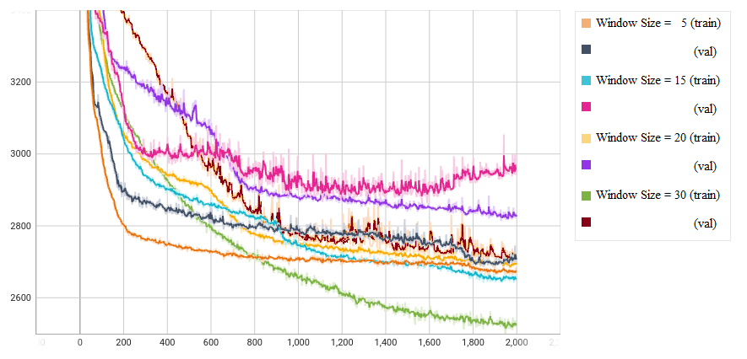
Varied Window Size, Fixed Learning Rate
Hubert Loss
MSE

Slide 26
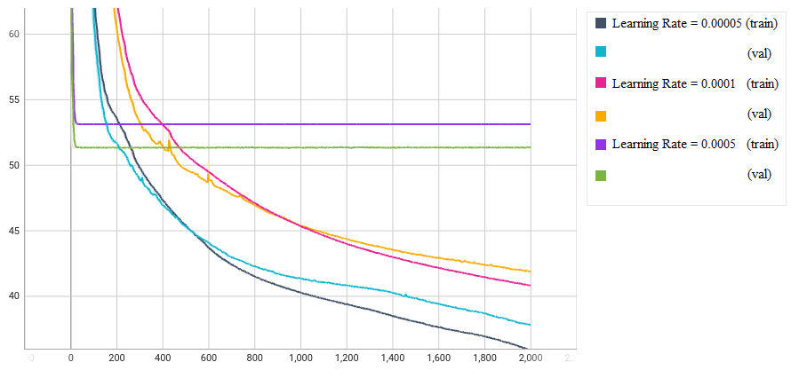
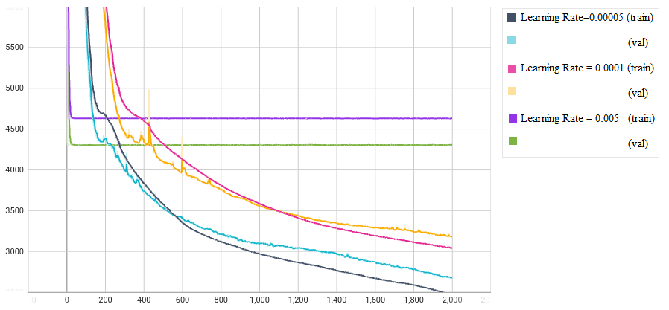
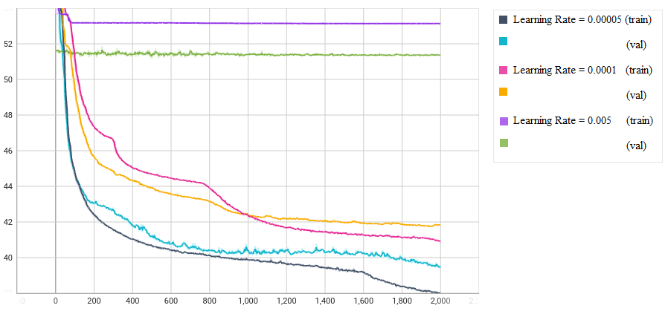
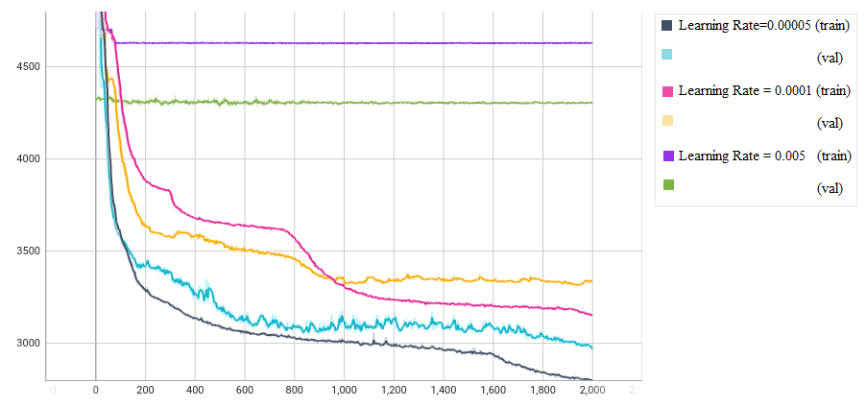
Findings
Larger Window Sizes == Good Performance
Split-CNN
LSTM
Hubert Loss
MSE

Slide 27
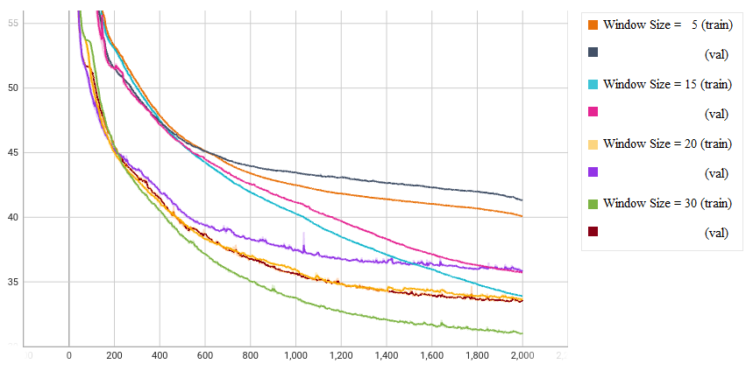
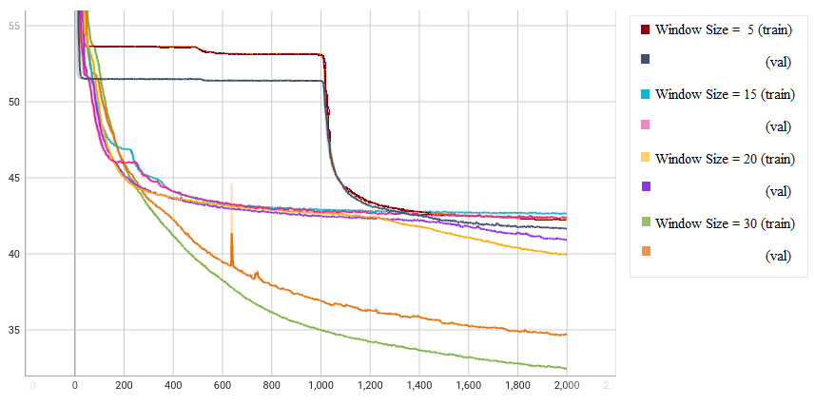
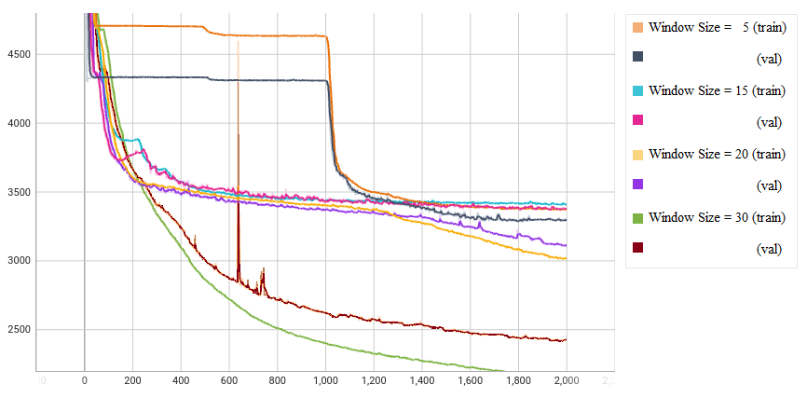
Findings
Larger Window Sizes == Good Performance
Split-CNN
LSTM
Hubert Loss
MSE

Slide 28
Split CNN - Best Performance
Eye trajectory predictions rely more on the last few time steps
Longterm memory may not be necessary
Larger window Size (30) is optimal
Smaller Learning Rate (0.0001) is optimal

Slide 29
Model 4 - Blink Split CNN
Predicted Eye Trajectories
120 Features
x₁,x₂, …, x₁₂₀
Eye Trajectories
Feature x₁
CNN₁
tanh
tanh
BatchNorm
Dense
BatchNorm
Dense
Dense
Dropout
Dropout
.
..
Eye Trajectories
Feature x_{i}
Concatenated Blink + Eye Predictions
CNN_{i}
Concatenated 120 CNN Outputs
tanh
Predicted Blinks
.
..
tanh
BatchNorm
Dense
tanh
Dense
BatchNorm
sigmoid
Dense
Eye Trajectories
Feature x₁₂₀
Dropout
Dropout
CNN₁₂₀
tanh

Slide 30
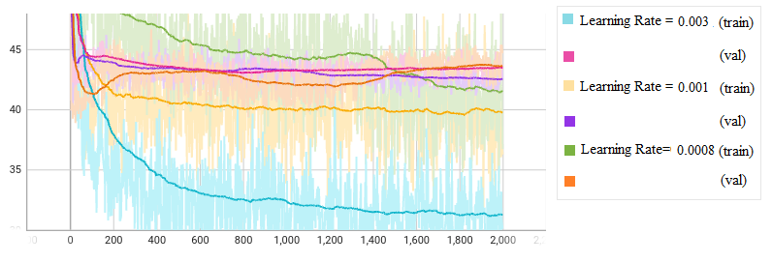
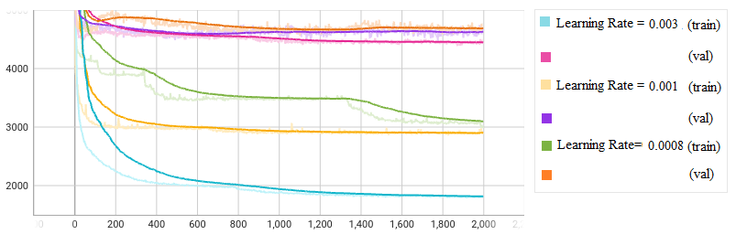
Blink Split CNN - Eye Features
Varied Learning Rates, window size 30 for Eye Features
Hubert Loss
MSE

Slide 31
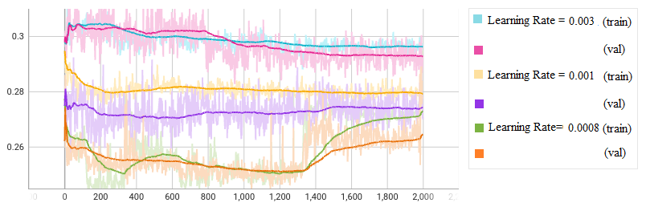
Blink Split CNN - Blink State
Validation goes up

Slide 32
Conclusions
WebGazer Eye data is Noisy and leads to Unstable Training
Finding Correct Architecture with Blinks is Hard
Overfit training data, with lower MSE
Performs poorly on validation
Eye Normalization may be helpful
Combine Tobius Eye Tracker Data

Slide 33
Thank You

